Slide 1
Large Language Models for OpenAPI Definition Autocompletion
Project author: Bohdan Petryshyn
Supervisor: Assoc. Prof. Dr. Mantas Lukoševičius

Slide 2
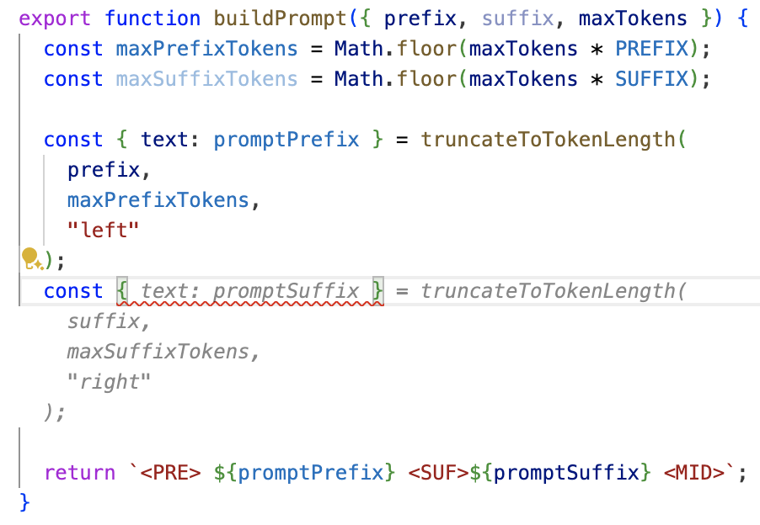
Terms: code completion
Symbol-level vs Snippet-level autocompletion
Bohdan Petryshyn 1

Slide 3
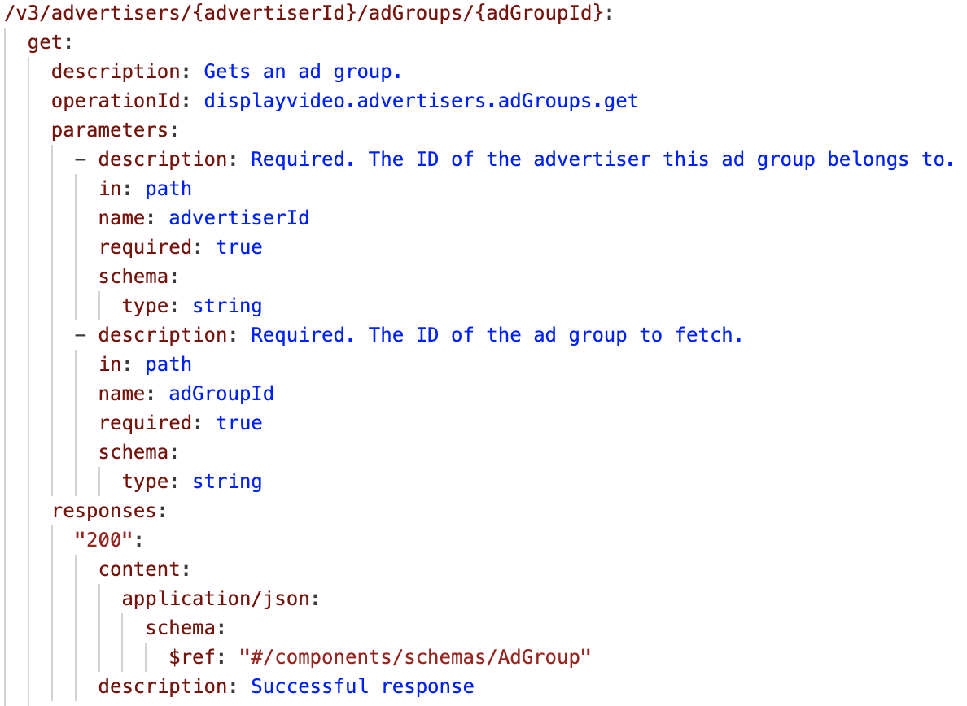
Terms: OpenAPI specification and definition
OpenAPI Specification is a standard for defining APIs in a machine and human-readable format.
OpenAPI Definition is a document describing an instance of an API following the specification.
Bohdan Petryshyn 2

Slide 4
Project relevance and novelty
Problem:
Despite the remarkable efficacy of code completion solutions in mainstream programming languages, their performance lags when applied to less ubiquitous formats such as OpenAPI definitions.
Achievements:
A novel semantics-aware OpenAPI completion benchmark is implemented.
GitHub Copilot, one of the most widely used commercial solutions is evaluated.
The fine-tuned model demonstrates a peak correctness improvement of 55.2% over GitHub Copilot despite utilizing 25 times fewer parameters and being free and open-source.
An improvement to a commonly used fill-in-the-middle training objective is proposed.
3 Bohdan Petryshyn

Slide 5
Project aims and objectives
The aim of this research is to investigate the approaches for utilizing large language models for developing and optimizing an OpenAPI completion solution that would outperform the existing commercial or open-source solutions in this task.
Objectives:
To analyze the state of the art in code generation and evaluation and identify the challenges in this area in the context of OpenAPI completion.
To identify the baseline solution as well as the foundational model for the study.
To design and implement a semantics-aware benchmark for the task.
To design and implement a reusable integrated OpenAPI completion solution.
To propose a set of prompt engineering and fine-tuning techniques for optimizing the foundational model’s performance.
To evaluate the performance of the proposed solution, compare it to the baseline and analyze the impact of the hypothesized performance improvement techniques.
Bohdan Petryshyn 4

Slide 6
Benchmark: existing solutions
None of the existing code generation benchmarks can be used for OpenAPI evaluation:
Machine translation metrics:
BLEU
METEOR
Levenshtein distance
Language-specific benchmarks
5 Bohdan Petryshyn

Slide 7
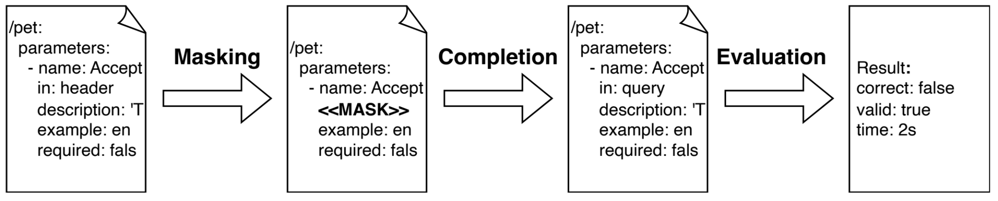
Benchmark: proposed methods
Benchmark Pipeline:
Metrics:
Correctness - how often the generated OpenAPI definition is semantically identical to the original one.
Validity - how often the generated OpenAPI definition is syntactically valid.
Speed - how fast the solution generates the OpenAPI definition.
Bohdan Petryshyn 5

Slide 8
Integrated solution: existing solutions
Commercial:
GitHub Copilot - the first widely adopted code completion tool.
AWS Code Whisperer - runner up, specializes in AWS services and libraries.
Tabnine - focuses the security of the user’s codebase.
Open-source:
Continue - model-agnostic IDE integration. Only works with instruction-trained models.
LLM-vscode - proof-of-concept VSCode extension from Hugging Face. Supports both infilling and instruction-trained models.
7 Bohdan Petryshyn

Slide 9
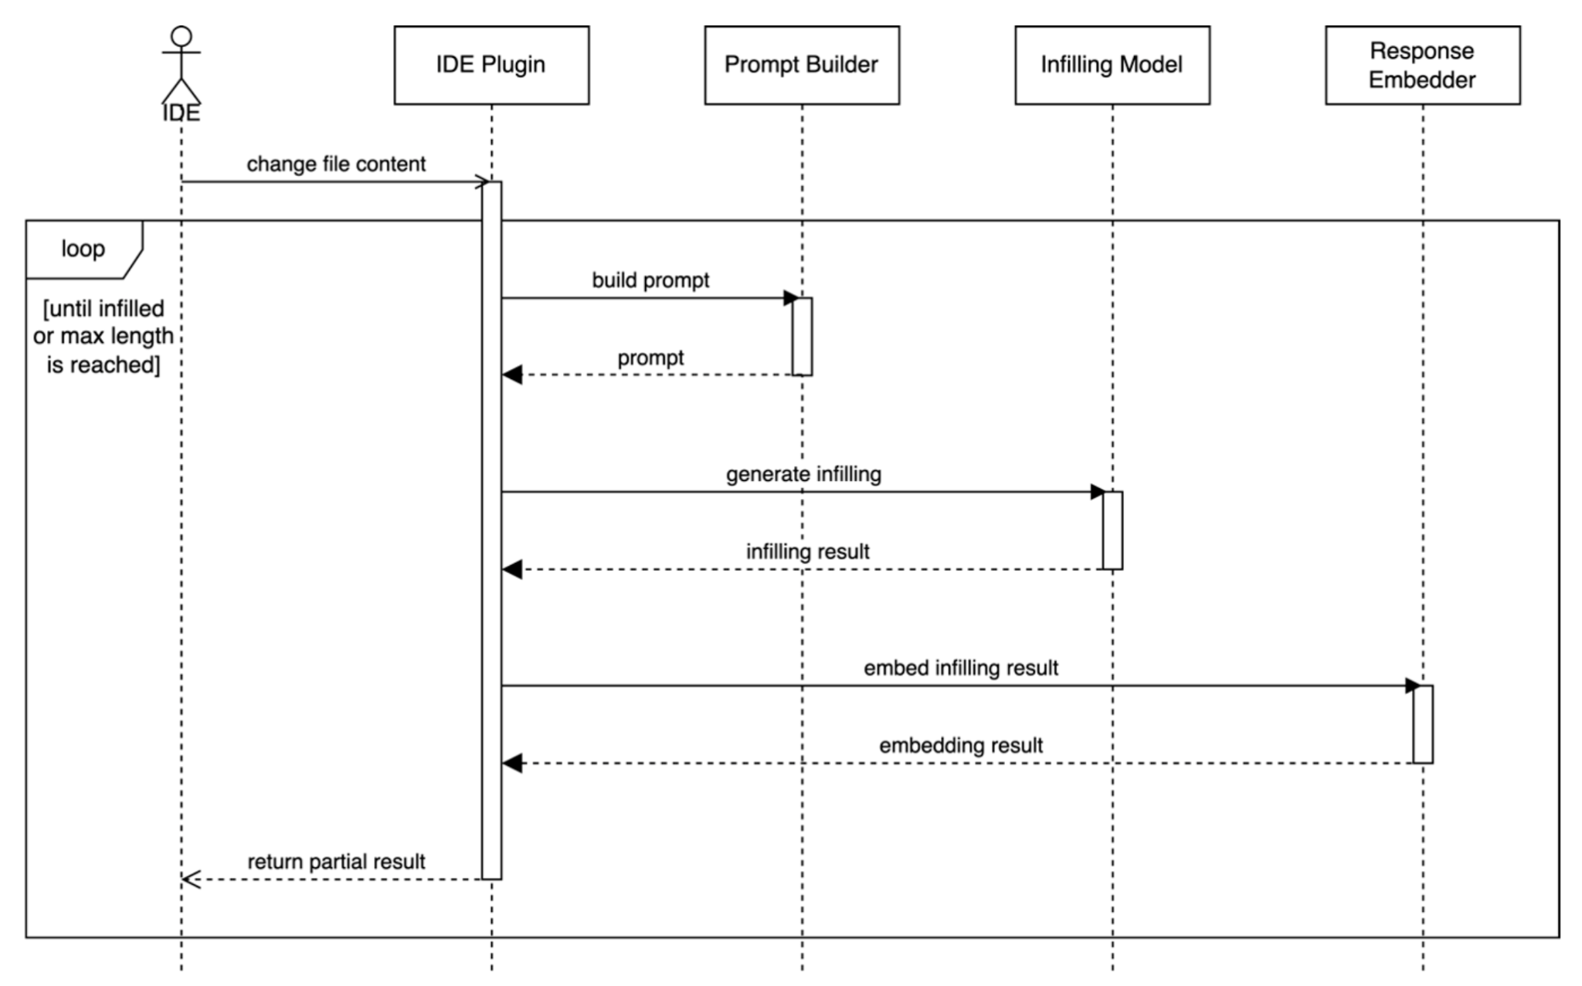
Integrated solution: architecture
Bohdan Petryshyn 6

Slide 10
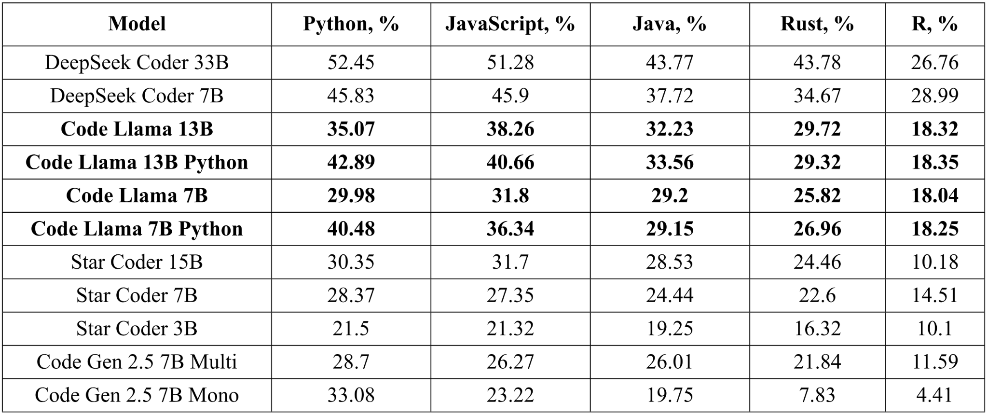
Integrated solution: open-source LLMs
6 Bohdan Petryshyn

Slide 11
Integrated solution: platforms and tools
Code Llama - foundational model.
Hugging Face Inference Endpoints - infrastructure platform. Allows serving LLMs as APIs.
Hugging Face Transformers and PEFT - fine-tuning and inference Python libraries.
Hugging Face Hub - dataset and model storage.
Google Colab with Nvidia A100 GPU - training platform.
JavaScript - cross-platform language for solution implementation.
Bohdan Petryshyn 10

Slide 12
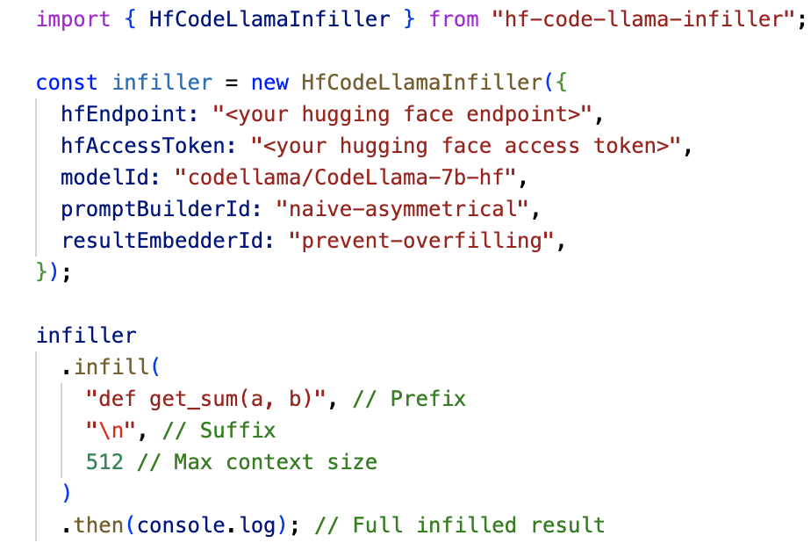
Integrated solution: implementation
The solution was published as a JavaScript package that can be used in any web-based code editor or an IDE supporting JavaScript plugins.
11 Bohdan Petryshyn

Slide 13
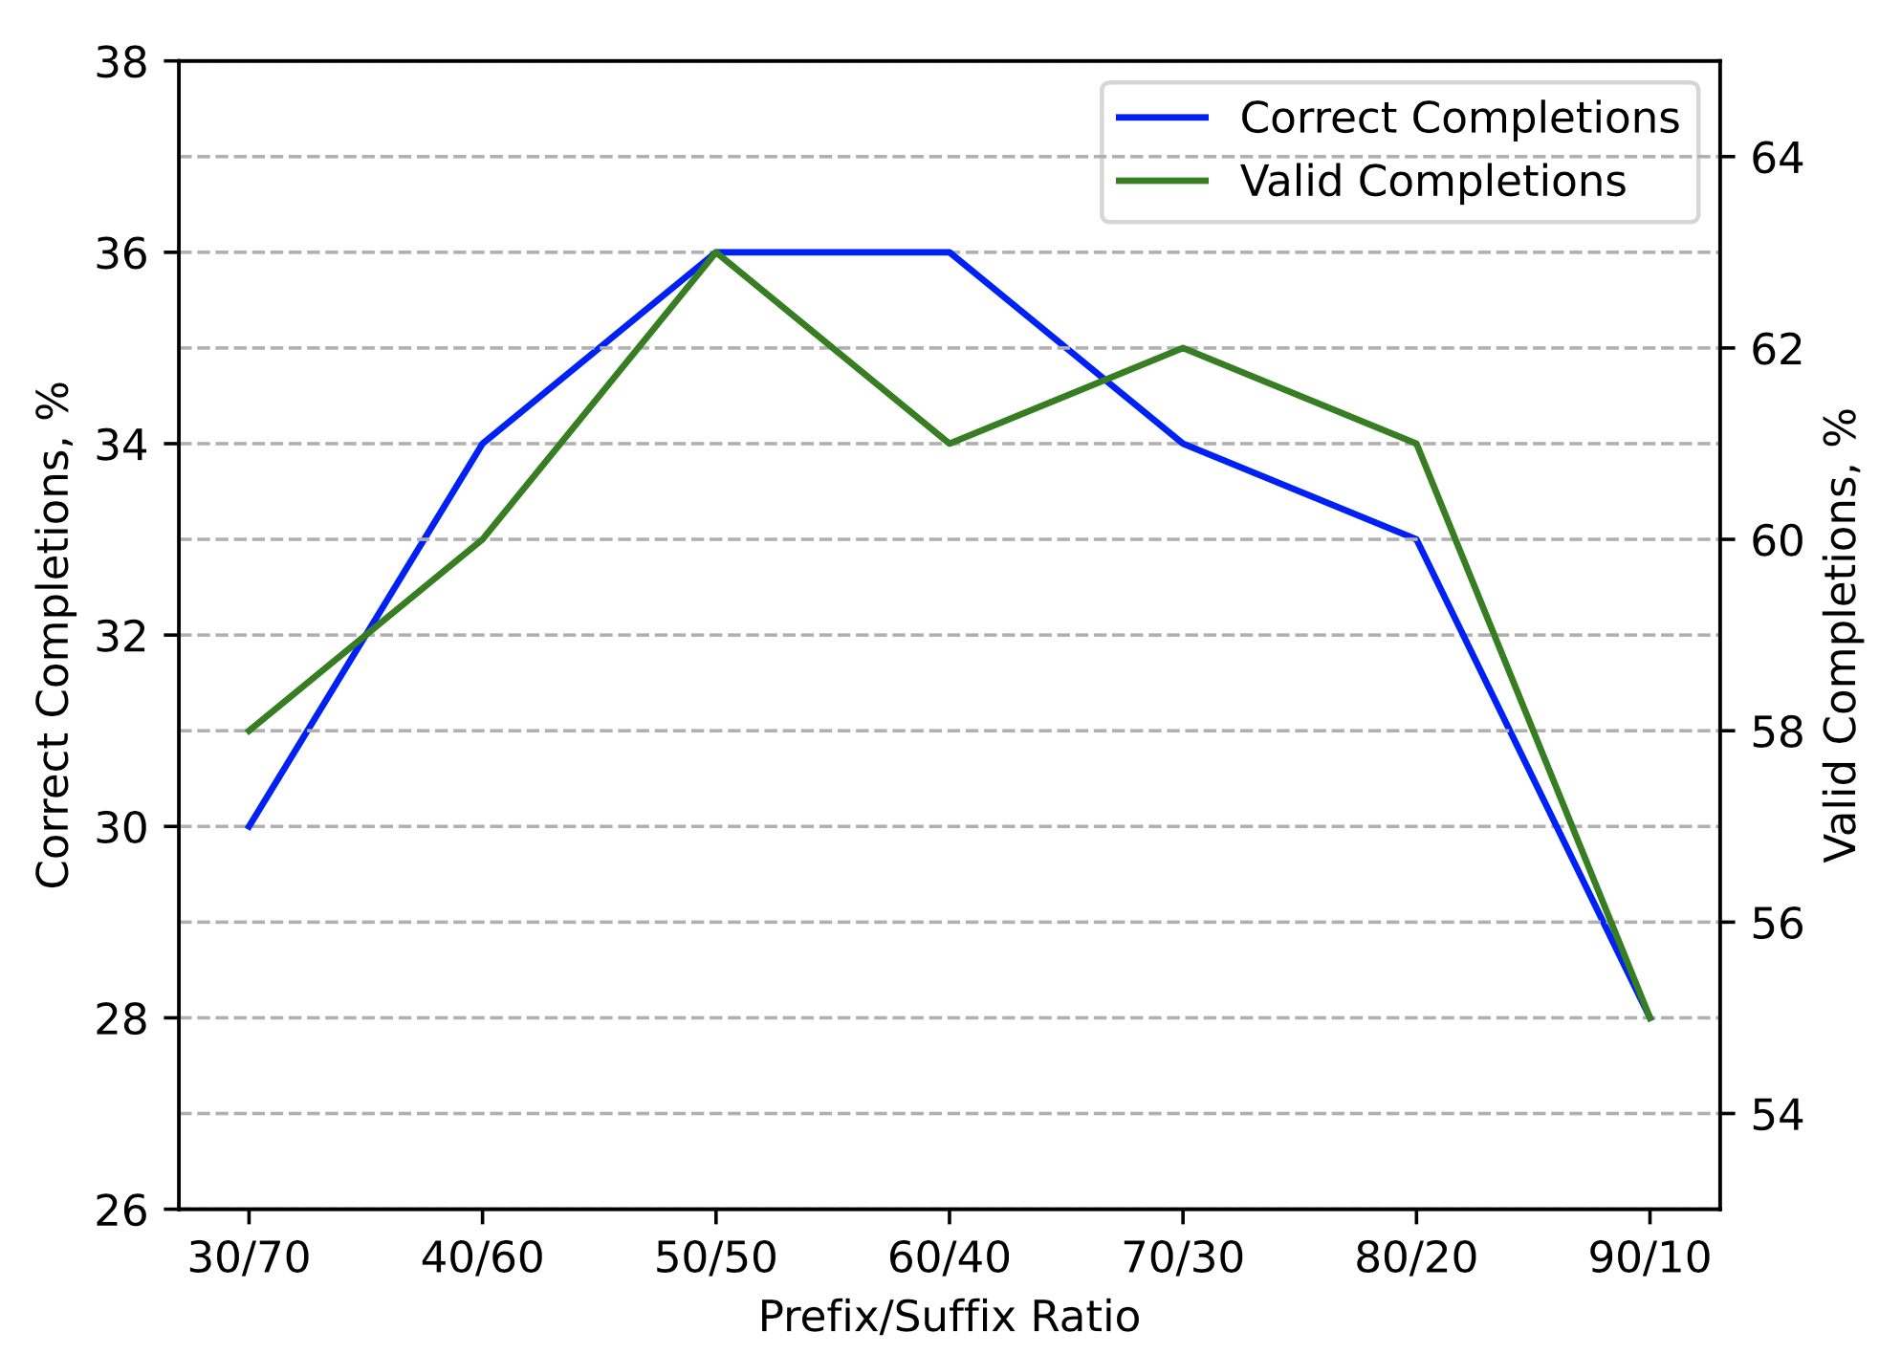
Code Llama performance optimization: optimal prefix-to-suffix ratio
50/50 prefix-to-suffix ratio shows the best performance and doesn’t discriminate either prefix or suffix.
Bohdan Petryshyn 7

Slide 14
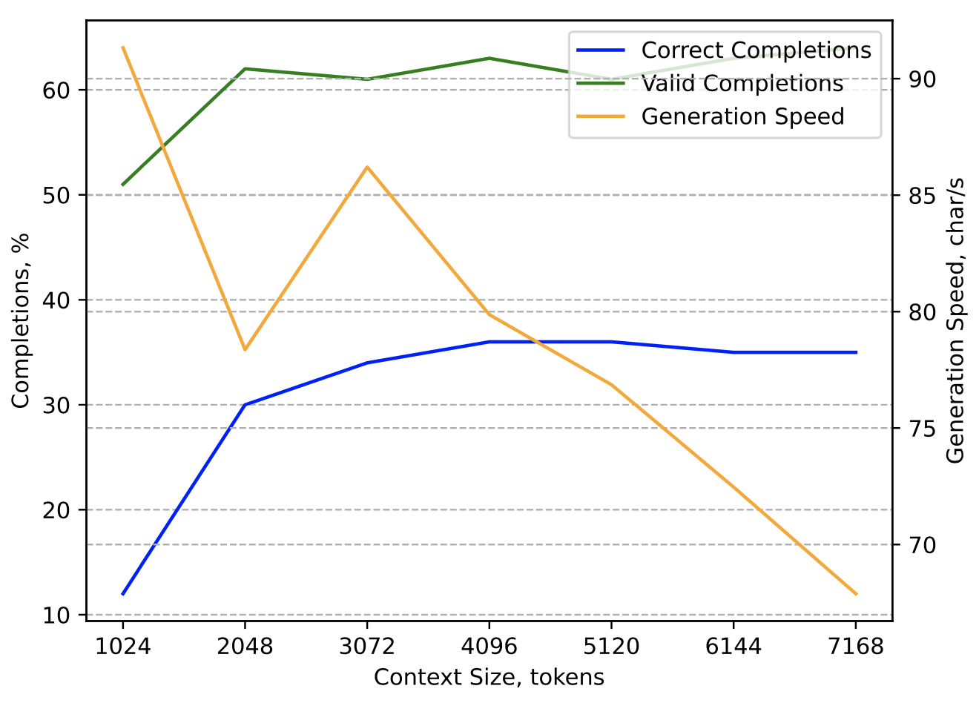
Code Llama performance optimization: optimal context size
After the context size of 4,096 tokens, minor performance improvements come at a cost of significant speed decrease.
Bohdan Petryshyn 8

Slide 15
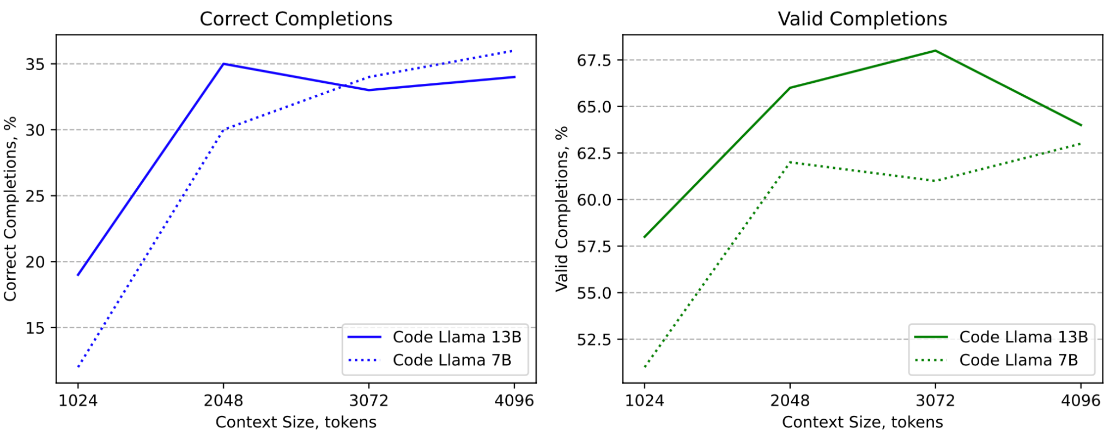
Code Llama performance optimization: model size
Larger Code Llama 13B model does not show significant performance improvement over the 7B version. Considering the quadrupled memory requirements, this draws larger models not practical for the OpenAPI completion task.
Bohdan Petryshyn 9

Slide 16
Code Llama performance optimization: optimal prefix-to-suffix ratio
After the context size of 4,096 tokens, minor performance improvements come at a cost of significant speed decrease.
50/50 prefix-to-suffix ratio shows the best performance and doesn’t discriminate either prefix or suffix.
Larger Code Llama 13B model does not show significant performance improvement over the 7B version.
Bohdan Petryshyn 7

Slide 17
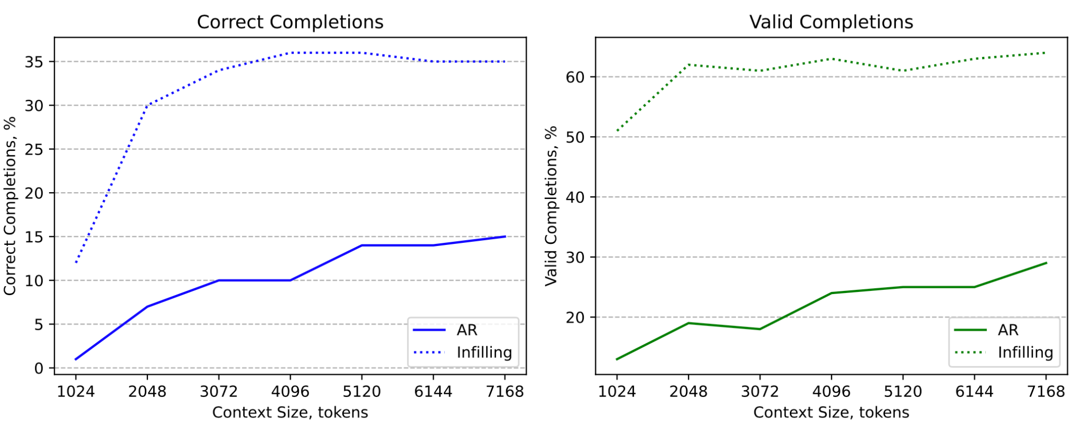
Code Llama performance optimization: AR generation vs infilling
Infilling is essential for code completion with Code Llama.

Slide 18
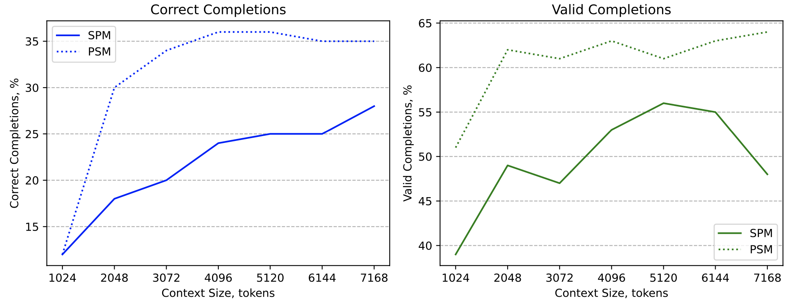
Code Llama performance optimization: prefix-suffix-middle vs suffix-prefix-middle
Code Llama severely underperforms in the SPM format because of the split token problem.

Slide 19
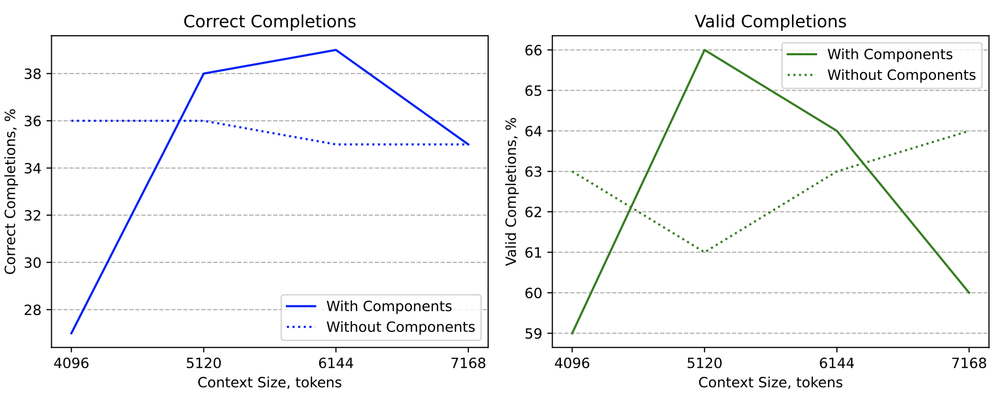
Code Llama performance optimization: metadata in prompt
Adding OpenAPI components to the prefix only leads to marginal performance improvement and even harms the correctness at lower context sizes.
Bohdan Petryshyn 15

Slide 20
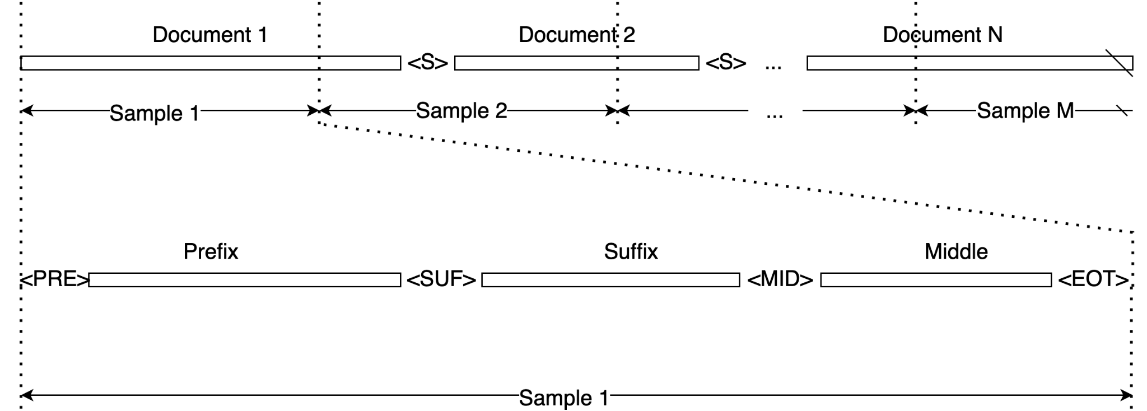
Code Llama performance optimization: fill-in-the-middle training objective
8 Bohdan Petryshyn

Slide 21
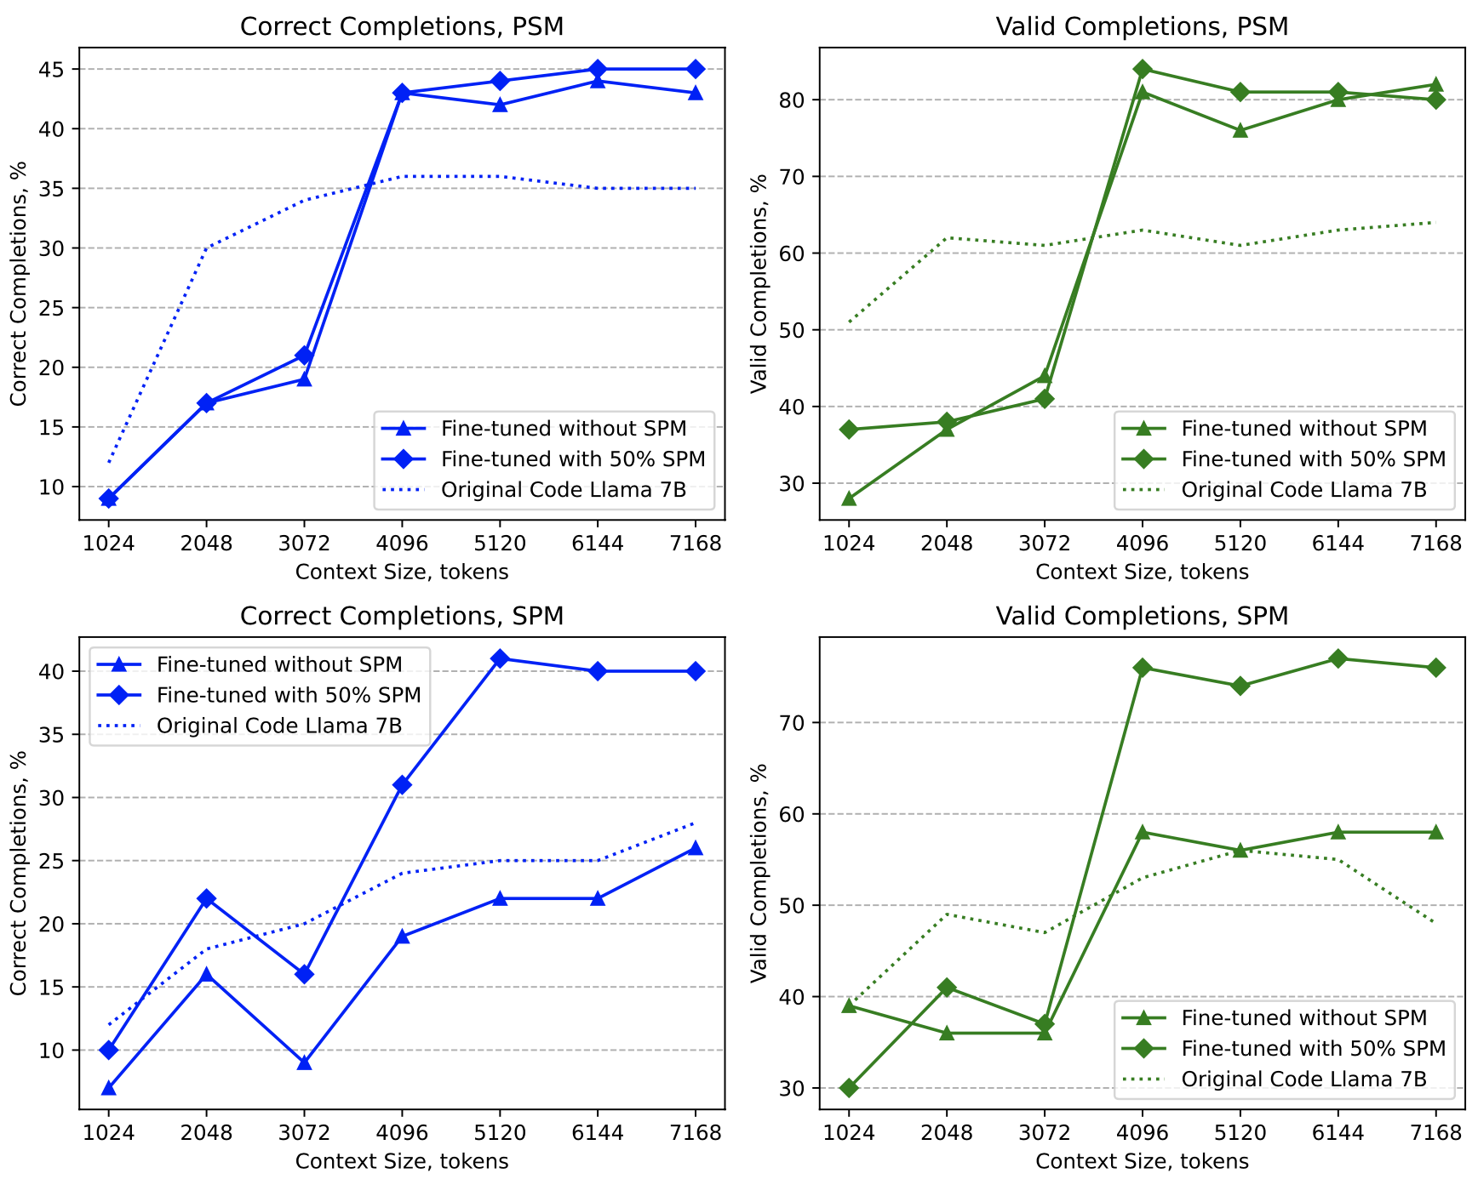
Code Llama performance optimization: fine-tuning with PSM and a mixture of PSM and SPM formats
Using the mixture of formats leads to slight improvement in PSM format and a significant improvement to the SPM format.
Model underperforms at context sizes smaller than 4,096 tokens which is the context size used for fine-tuning.
9 Bohdan Petryshyn

Slide 22
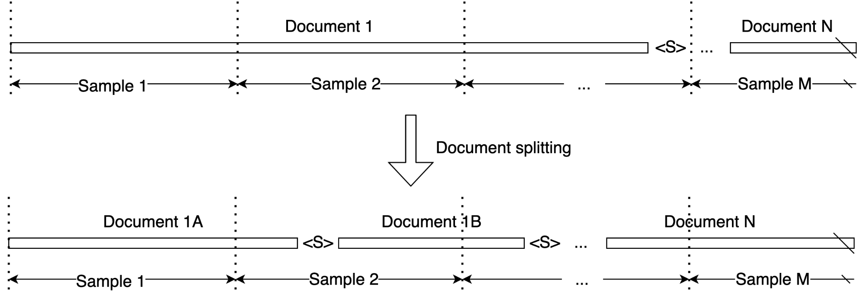
Code Llama performance optimization: document splitting
10 Bohdan Petryshyn

Slide 23
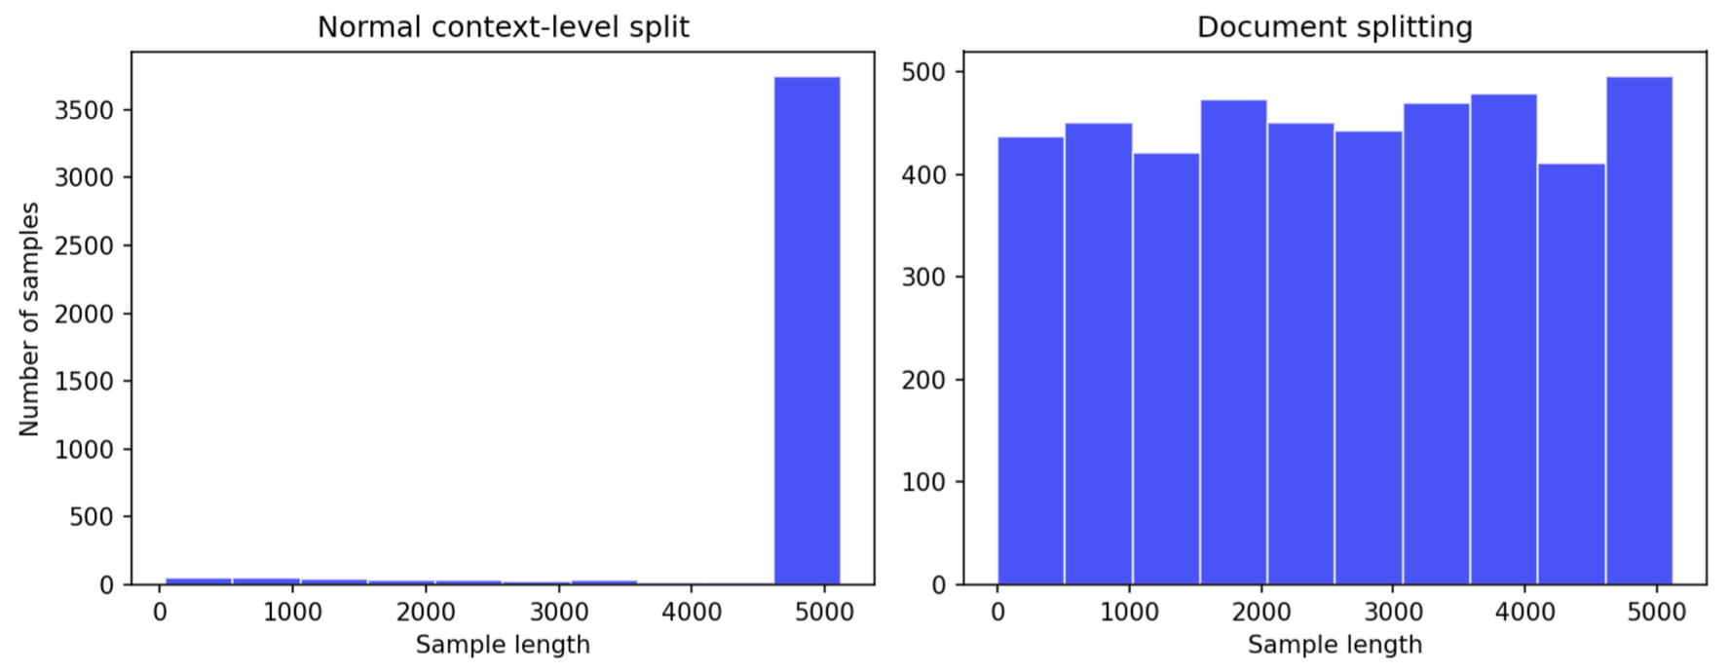
Code Llama performance optimization: sample length distribution
Splitting documents before the FIM transformation (0.8-1.2 context size) helps achieving a uniform distribution of the training sample sizes.
11 Bohdan Petryshyn

Slide 24
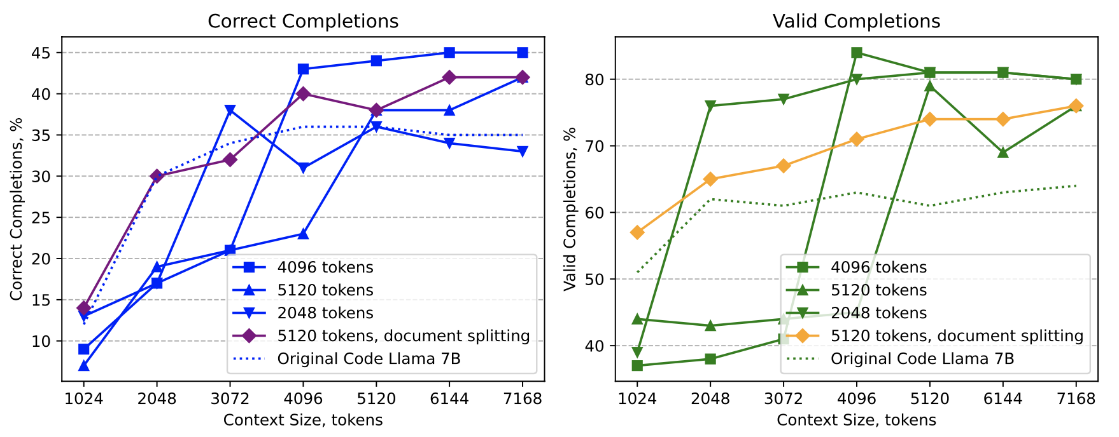
Code Llama performance optimization: document splitting
Models trained at 2048, 4096, and 5120 token context lengths underperform when prompted with context sizes smaller than during fine-tuning.
Model trained with 5120 tokens and the document splitting technique demonstrates much more stable performance.
12 Bohdan Petryshyn

Slide 25
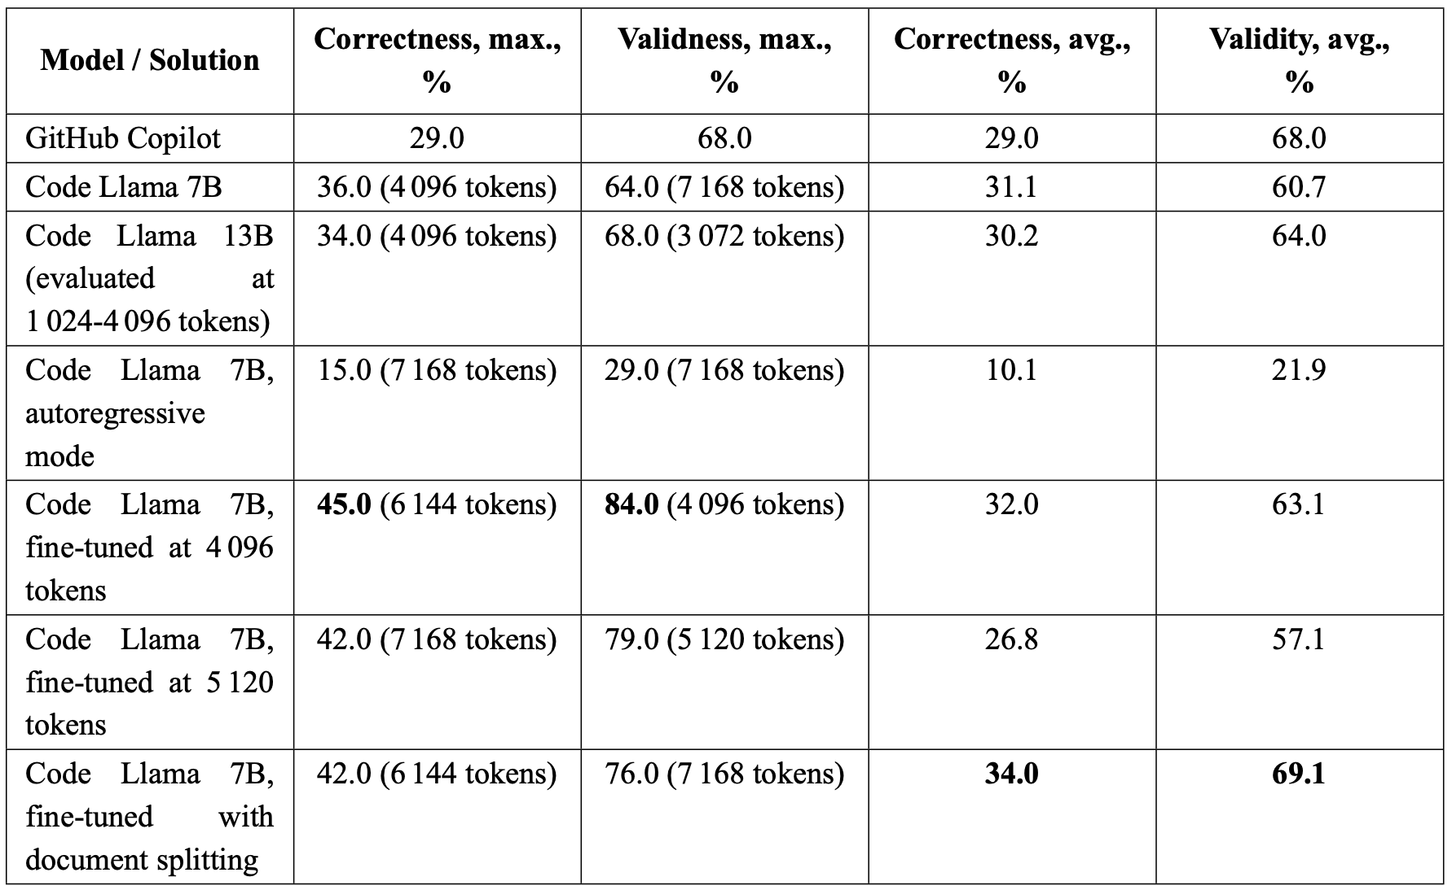
Code Llama performance optimization: comparison
13 Bohdan Petryshyn

Slide 26
Conclusions
A novel semantics-aware OpenAPI completion benchmark was implemented and published on GitHub [1].
GitHub Copilot, one of the most widely used commercial solutions correctly completes 29% of the definitions.
Code Llama 7B model with optimal prompt format correctly completes 36% of the definitions and outperforms Copilot by 24.1%.
The fine-tuned model demonstrates a peak correctness of 45% outperforming GitHub Copilot by 55.2% despite utilizing 25 times fewer parameters and being open source. The training pipeline is available at GitHub [2].
The proposed document splitting technique improves the widely used FIM training objective.
Part of the research is submitted to the IEEE Transactions on Software Engineering journal (CiteScore: 9.7). The preprint is available at Arxiv [3].
https://github.com/BohdanPetryshyn/openapi-completion-benchmark
https://github.com/BohdanPetryshyn/code-llama-fim-fine-tuning
https://arxiv.org/abs/2405.15729
14 Bohdan Petryshyn
Notes:
To the best of my knowledge, this is the first research investigating Code Llama fine-tuning for code infilling. The source code was made publicly available at GitHub and I already received some inquiries from people who found this research helpful.

Slide 27
Conclusions: state of the art review
Objective:
To analyze the state of the art in code generation and evaluation and identify the challenges in this area in the context of OpenAPI completion.
Conclusion:
Modern solutions are based on transformer architectures which require large amounts of data and computational resources to train.
Task-specific optimizations can lead to competitive advantage in code completion.
Semantics-aware OpenAPI completion benchmark hasn’t been developed yet.
15 Bohdan Petryshyn

Slide 28
Conclusions: baseline solution and foundational model
Objective:
To identify the baseline solution as well as the foundational model for the study.
Conclusion:
GitHub Copilot, one of the most widely adopted commercial solutions was selected as the baseline solution for the study.
Code Llama, an open-source LLM from Meta was selected as the foundational model for the proposed solution implementation due to its permissive license, best-in-class performance, large context size support, and infilling capabilities.
16 Bohdan Petryshyn

Slide 29
Conclusions: OpenAPI completion benchmark
Objective:
To design and implement a semantics-aware benchmark for the task.
Conclusion:
Three metrics were proposed: correctness, validity, and generation speed.
The correctness metric tolerates the possible variations from the ground truth completion using a set of heuristics.
To the best of the author’s knowledge, the proposed benchmark is the first publicly available evaluation framework for OpenAPI completion. The benchmark is available on GitHub: https://github.com/BohdanPetryshyn/openapi-completion-benchmark
17 Bohdan Petryshyn

Slide 30
Conclusions: integrated solution
Objective:
To design and implement a reusable integrated OpenAPI completion solution.
Conclusion:
The OpenAPI completion solution proposed in this research is based on a modular architecture that enables easy alteration of the prompt building, infilling, and result embedding strategies.
The solution was implemented and published as a JavaScript package that can be used with any IDE that supports JavaScript plugins or any web-based code editor. The package is available on NPM: https://www.npmjs.com/package/hf-code-llama-infiller
18 Bohdan Petryshyn

Slide 31
Conclusions: optimization techniques
Objective:
To propose a set of prompt engineering and fine-tuning techniques for optimizing the foundational model’s performance.
Conclusion:
Optimal prefix-to-suffix search
Optimal context size search
Optimal model size search
Optimal generation mode and prompt format search
Inclusion of OpenAPI metadata in the prompt
Fine-tuning with joint PSM and SPM formats
Fine-tuning with the novel document splitting technique
First Code Llama fine-tuning pipeline on GitHub: https://github.com/BohdanPetryshyn/code-llama-fim-fine-tuning
19 Bohdan Petryshyn

Slide 32
Conclusions: experimental results
Objective:
To evaluate the performance of the proposed solution, compare it to the baseline and analyze the impact of the hypothesized performance improvement techniques.
Conclusion:
Code Llama 7B model with optimal prompt format outperforms Copilot by 24.1%.
Larger Code Llama 13B doesn’t show significant improvement.
Infilling mode is essential for code completion. Decrease of 72.2% is observed without.
YAML format is not only easier for human but for Code Llama model as well. 25% correctness decrease is observed in JSON format.
Task-specific fine-tuning improved Code Llama 7B by 28.6% outperforming Copilot by 55.2%.
Document splitting fixed the problem of underperformance on small context sizes and resulted in the highest average performance of 34%.
20 Bohdan Petryshyn

